Slide 1


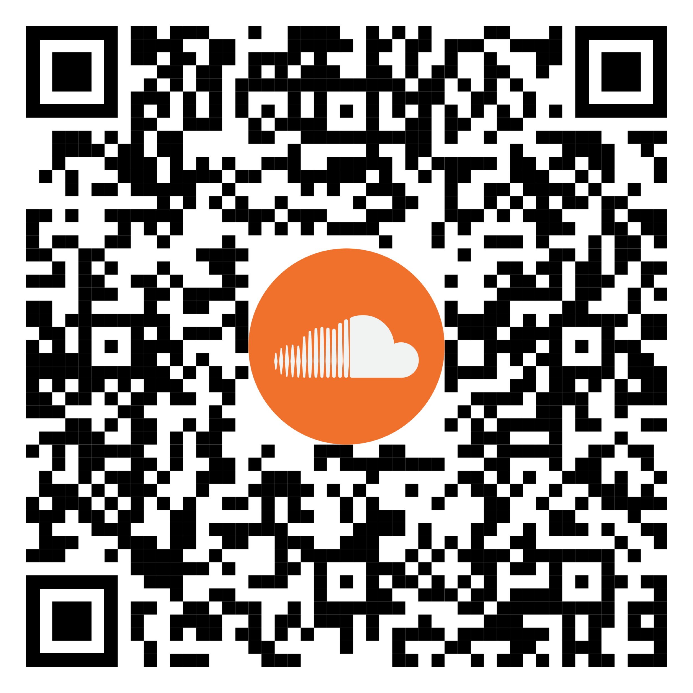
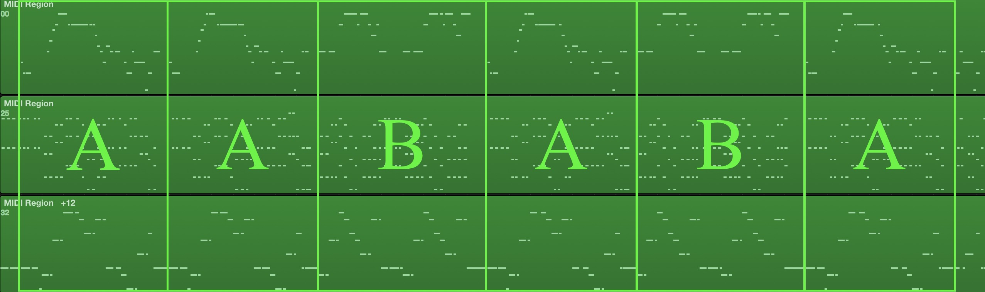
BandNet: A Neural Network-Based, Multi-Instrument Beatles-Style MIDI Music Composition Machine
Yichao Zhou^{1,2} Wei Chu¹ Sam Young^{1,3} Xin Chen¹
¹Snap Inc. ²EECS, University of California, Berkeley.
³Herb Alpert School of Music, University of California, Los Angeles.
What is Special About The Beatles?
Professional Scoring
The Beatles are one of the most influential bands;
Challenging for modeling due to style variations, e.g.,
  some have monophonic melodies, others are two-part;
  contain many non-standard combinations of notes that are different from the common chord triads
A professional music composer evaluated the music generated by each version of BandNet as an ablation study.
The composer gave scores (1-5) for each metric:
  Content Quality (CQ): how well the notes and rhythms function according to music theory principles;
  Structure Quality (SQ) was defined as to what extent the music sample exhibits an organizational structure.
We reported two overall scores to evaluate the overall quality of each multiple-channel song:
  The Averaged Content and Structure Quality (ACSQ): averaging the CQs and SQs of all the channels;
  Group Synergy Quality (GSQ):evaluated how well the individual channels work together to make a unified whole.
Score Encoding
01. | NXT_CHNL | 16. | NEW_NOTE(F5)
02. | NEW_NOTE(C5) | 17. | NXT_CHNL
03. | NEW_NOTE(G4) | 18. | NEW_NOTE(C5)
04. | NEW_NOTE(E4) | 19. | NEW_NOTE(G4)
05. | NXT_CHNL | 20. | NEW_NOTE(E4)
06. | NEW_NOTE(C3) | 21. | NXT_CHNL
07. | NXT_STEP | 22. | CNT_NOTE(C3)
08. | NEW_NOTE(G5) | 23. | NXT_STEP
09. | NXT_CHNL | 24. | NEW_NOTE(E5)
10. | CNT_NOTE(C5) | 25. | NXT_CHNL
11. | CNT_NOTE(G4) | 26. | CNT_NOTE(C5)
12. | CNT_NOTE(E4) | 27. | CNT_NOTE(G4)
13. | NXT_CHNL | 28. | CNT_NOTE(E4)
14. | CNT_NOTE(C3) | 29. | NXT_CHNL
15. | NXT_STEP | 30. | NEW_NOTE(C3)
Network Structure
Table 1: Results of a professional composer evaluating the quality of music generated by different models. MGT-M: Magenta’s MelodyRNN, MGT-P: Magenta’s PolyphonyRNN, BN: BandNet without note features, BN-S: BN with silence features, BN-SB: BN-S with beat features, BN-SBK: BN-SB while keeping notes in the key, BEATLES: original Beatles’ songs.
Subjective Listening
Dataset
We asked subjects to listen to 5 well-known songs by the Beatles, such as I Want to Hold Your Hand (1964), in order to familiarize them with the Beatles’ musical style;
We asked subjects to listen to the 15 testing songs mentioned above and to answer the following 4 questions (score 1-5):
  Have you heard this song before?
  Does it sound similar to the music of the Beatles?
  How likely is it that this music was professionally composed?
  How interesting is this music?
We collect and clean 123 The Beatles’ MIDIs from the Internet
Each MIDI contains the following channels:
  Vocal Melody
  Chord
  Bass Line
Pipeline for Generating a Complete Song
Users pick a seed for each section (verse/chorus);
LSTM-RNN generates multiple clips for each section;
Users listen to the clips and pick the ones they want;
BandNet builds a song according to a structure template.
Score (higher is better)
4
3
2
Group A: BandNet, Generated Seeds
Group B: BandNet, Professional Seeds
Group C: The Beatles’ Music
Style Similarity Professional Sounding Interestingness
Figure: Result of a user study that evaluates the performance of different ways to generate music. The x-axis represents the sources of the music and the y-axis represents the score. The box plot shows the distribution of the average score of each song rated by the listener. From bottom to top, the horizontal lines of each box show the minimum, the first quartile, the median, the third quartile, and the maximum of the average score, respectively.
Figure: The piano roll of the song Yesterday (1965). It has a song structure AABABA, whose sections are labeled in green in the Figure. The channels from top to bottom are melody, chords, and bass line.

