Slide 1
BandNet: A Neural Network-Based, Multi-Instrument Beatles-Style MIDI Music Composition Machine
Yichao Zhou^{1,2} Wei Chu¹ Sam Young^{1,3} Xin Chen¹
¹Snap Inc. ²EECS, University of California, Berkeley.
³Herb Alpert School of Music, University of California, Los Angeles.
Notes:
Good afternoon, everyone, I am Yichao Zhou from UC Berkeley. I will present our work, BandNet: A Neural Network-Based, Multi-Instrument Beatles-Style MIDI Music Composition Machine.

Slide 2
Computer Music Composition
GOAL: Automatically generate music scores
  Generate musics for photo albums
  Build royalty-free sound libraries
  Harmonize vocal singing
Notes:
The goal of computer-based music composition is to automatically generate musical score. Such tool has a wide range of applications such as [READ]

Slide 3
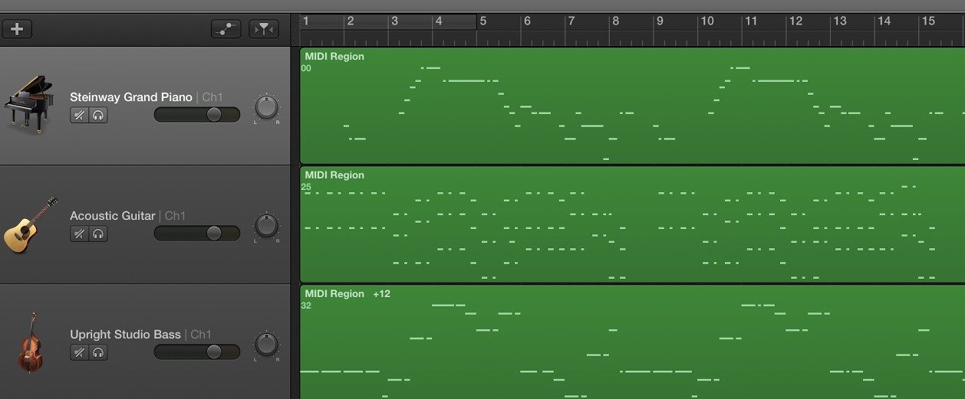
“The Beatles” Dataset
123 MIDI files from “The Beatles”
4 labelled channels
  Melody (vocal part)
  Chords (harmony part)
  Bass
  Drum
Notes:
Formed in 1960, The Beatles are arguably one of the most influential bands of all time. We found it interesting to build a machine learning model that can reproduce beatles-style music.
All the machine learning models rely on a good dataset. So we prepare the “the beatles” dataset, which contains 123 MIDI songs from the “The Beatles”. Each midi file has four labelled channels. They are the melody channel, which contains vocal part, the chord channel, which contains the harmony part, the bass channel, which contains the low-pitch part, and finally the drum channel.

Slide 4
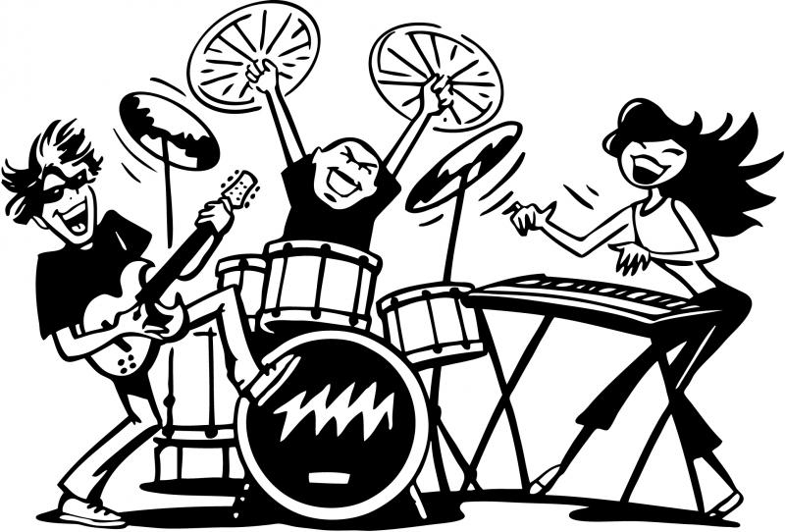
Challenges
Limitation of existing works (Magenta, FolkRNN, BachBot)
Cannot support multiple instruments (Band!)
Lack of song structure
Notes:
One limitation of existing works is that they don’t directly support multiple instruments. Modern music such as the Beatles, does use multiple instruments to cover the full sound range, and which people like.
Second, many people who have listened to the computer generated music samples tell us that they sounds good in short term, but lack a global structure. This is also the problem we are going to solve.

Slide 5
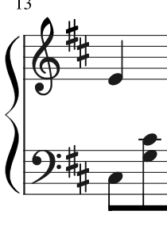
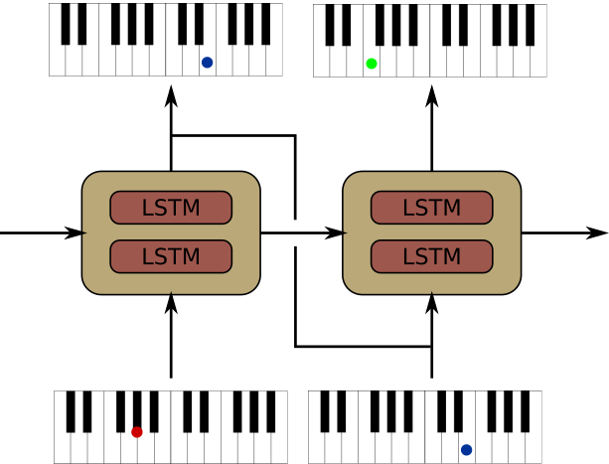
Encoding the Score
LSTM-RNN: How to deal with multiple instruments?
  RNN only takes a sequence as input
NEW_NOTE E4
NEXT_CHANNEL
NEW_NOTE C3
NEXT_STEP
CONTINUE_NOTE E4
NEXT_CHANNEL
NEW_NOTE G3
NEW_NOTE C3
NEXT_STEP
…
Melody
Bass
Notes:
Our machine learning model is based on recurrent neuron network constructed using stacked LSTM unit.
However, we know that RNN will only take a sequence as input, but a music score with mutiple instruments is more than a sequence. So here, we proposed our encoding scheme to turn the music scores with multiple instruments to a sequence of events. The idea is we run through this score from left to right, upper to bottom, and generate the event accordingly

Slide 6
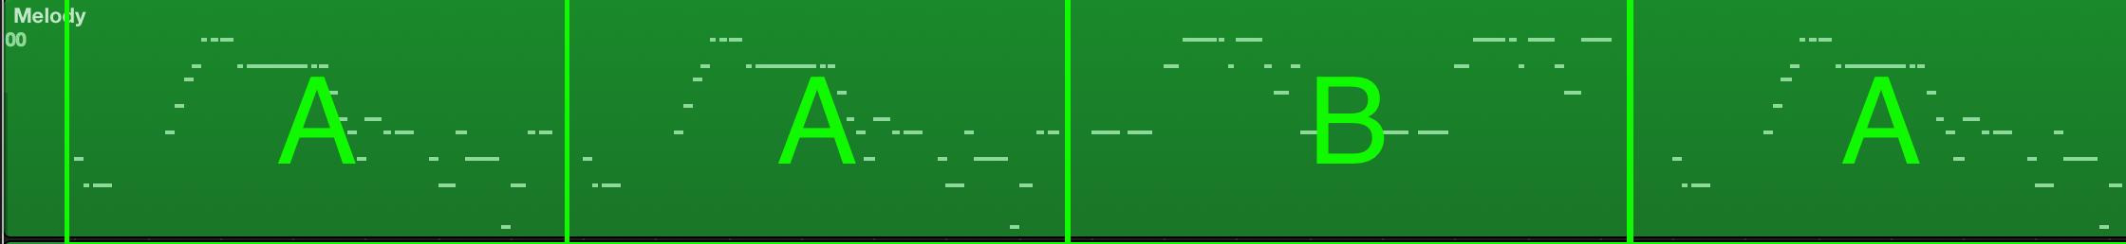
Music Assemble Pipeline
Users pick a seed for the each section;
LSTM-RNN generates music clips for each section;
Users listen to the clips and choose the one they like;
BandNet assembles the whole song according to a music structure template
Notes:
Most pop music including the music from the beatles has structures such as AABA. The melody in all the A sessions is very similar. To mimic this style, we uses a template-based music assemble pipeline.

Slide 7

Results (Subjective Listening)
We asked subjects to listen to 14 testing songs and answer the questions (1-5):
  Does it sound similar to the music from the Beatles?
  How likely is it that this music was professionally composed?
  How interesting is this music?
Style Similarity Profession Interestingness
Score (higher is better)
4
3
Group A: BandNet, Generated Seeds
Group B: BandNet, Professional Seeds
Group C: The Beatles’ Music
2
Notes:
This slides shows the subjective listening evaluation of our method. Let’s listen to a music sample.

Slide 8
Thank you for listening!

